Slide 1
Day 16
Kinematics of Wheeled Robots

Slide 2
Differential Drive
velocity constraint defines the wheel ground velocities
given the wheel ground velocities

Slide 3
Forward Kinematics
for a robot starting with pose [0 0 0]^{T} moving with velocity V(t) in a direction θ(t) :

Slide 4
Sensitivity to Wheel Velocity
σ = 0.05
σ = 0.01

Slide 5
Correction: ICC for Differential Drive

Slide 6
Forward Kinematics
for differential drive with
is this really the same as

Slide 7
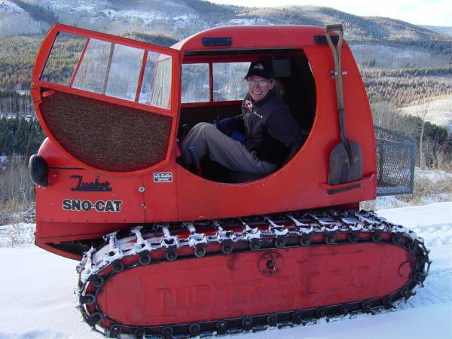
Tracked Vehicles
similar to differential drive but relies on ground slip or skid to change direction
kinematics poorly determined by motion of treads
http://en.wikipedia.org/wiki/File:Tucker-Kitten-Variants.jpg

Slide 8
Steered Wheels: Bicycle

Slide 9
Steered Wheels: Bicycle
important to remember the assumptions in the kinematic model
smooth rolling motion in the plane
does not capture all possible motions
http://www.youtube.com/watch?v=Cj6ho1-G6tw&NR=1#t=0m25s

Slide 10
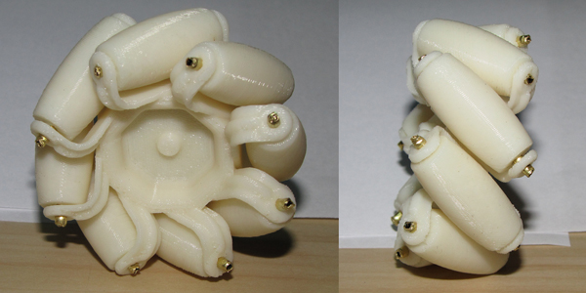
Mecanum Wheel
a normal wheel with rollers mounted on the circumference
http://www.youtube.com/watch?v=Cee1UZN0p98&feature=player_embedded
http://blog.makezine.com/archive/2010/04/3d-printable-mecanum-wheel.html

Slide 11
Mecanum Wheel
AndyMark Mecanum wheel specification sheet
http://d1pytrrjwm20z9.cloudfront.net/MecanumWheelSpecSheet.pdf

Slide 12
Dead Reckoning
the forward kinematics model we have used computes the pose of the robot based on the previous pose and velocity of the robot
there is no reference to the environment external to the robot
because new poses are computed based only on previous poses, any errors in the pose accumulate over time
the lack of external measurements prevents us from correcting the accumulated errors

